Slide 2

FireDAC
Secret Weapons
More than Delphi Data Access
Slides and samples
github.com/jimmckeeth/FireDAC-Secret-Weapons

Slide 3


Jim McKeeth
GDK Software
Embarcadero Delphi MVP
Director of Consulting
jim@gdksoftware.com
gdksoftware.com

Slide 4
INTERFACE
In-Memory Tables
Local SQL
Batch Move
NoSQL & MongoDB
New Security & Safety Features
More resources
Slides and samples for this session
github.com/jimmckeeth/FireDAC-Secret-Weapons
Review the fundamentals
github.com/jimmckeeth/FireDAC-Fundamentals

Slide 5
FireDAC: Your Ultimate Dataset Secret Weapon Elevate your data manipulation skills with FireDAC in this advanced session. Learn how to import, export, and migrate data efficiently in batches. Discover the power of executing SQL across diverse data sources, including joining tables from different databases. Explore techniques for working with NoSQL databases and even managing data without a database using in-memory datasets. This session will equip you with the tools to handle complex data scenarios with ease and precision.

Slide 6
IMPLEMENTATION

Slide 7
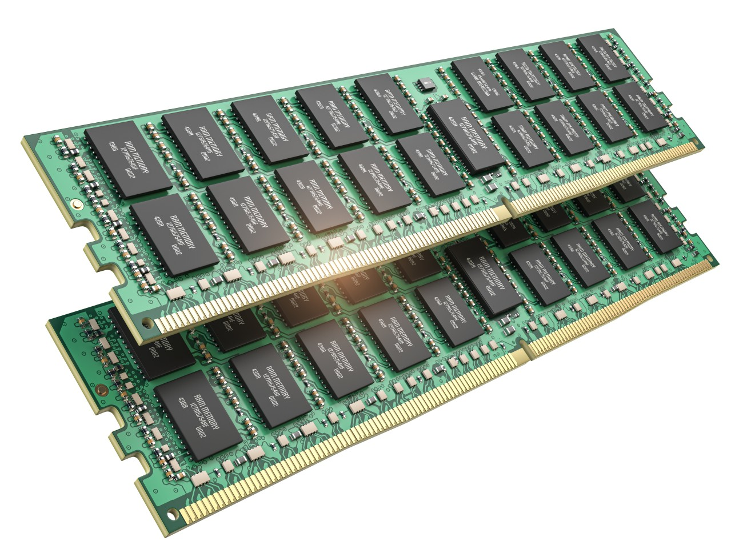


TFDMemTable
Similar to the TClientDataset
Less about keeping it in RAM
More NO DBMS Required
AKA “Disconnected Dataset”

Slide 8
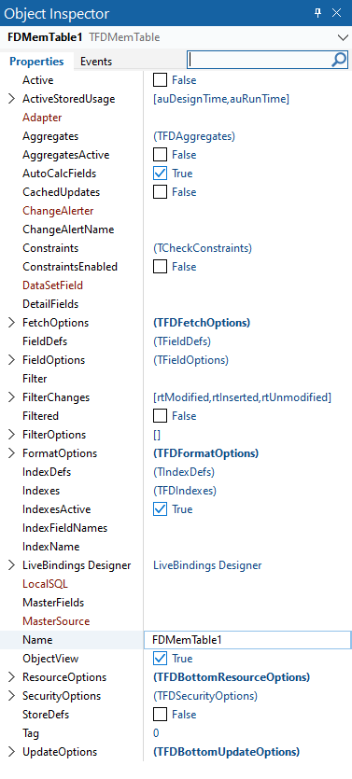
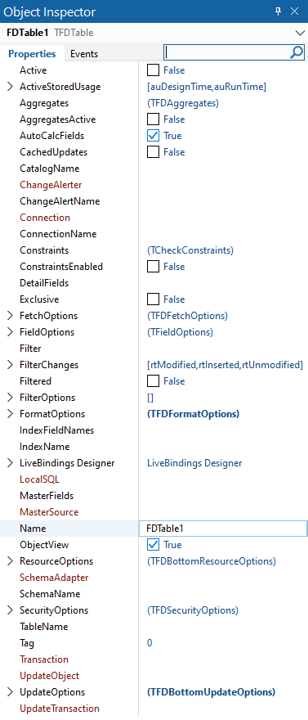
Comparing the properties of TFDMemTable to TFDTable
TFDMemTable
TFDTable

Slide 9
TFDMemTable descends directly from TFDAdaptedDataSet, while TFDQuery and TFDTable descend from TFDRDBMSDataSet.
TDataSet
TFDDataSet
TFDAdaptedDataSet
TFDRdbmsDataSet
TFDCustomQuery
TFDCustomMemTable
TFDTable
TFDQuery
TFDMemTable

Slide 10
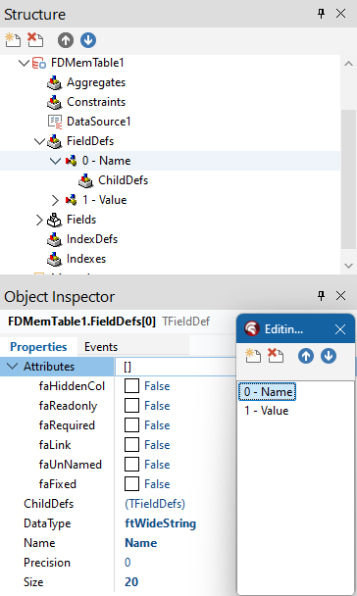
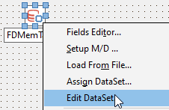
Creating TFDMemTable Dataset
One of the following
Define the fields via FieldDefs property
Load From File
Assign DataSet from another in project
Then optionally use Edit DataSet

Slide 11
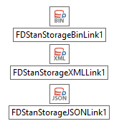
TFDMemTable Storage Components
For loading or saving, need a Storage Link based on the storage format used
sfBinary = TFDStanStorageBinLink → FireDAC.Stan.StorageBin.pas
sfXML = TFDStanStorageXMLLink → FireDAC.Stan.StorageXML.pas
sfJSON = TFDStanStorageJSONLink → FireDAC.Stan.StorageJSON.pas
sfAuto = based on file extension
The component does nothing besides add a unit to the uses (alternatively just add the unit).

Slide 12
TFDTableAdapter – Connecting the TFDMemTable
Connects the TFDMemTable to an DBMS via TFDCommand
Used to execute SQL queries, table updates, and transactions
Then transfers data from TFDCommand into TFDMemTable
TFDConnection
TFDMemTable
TFDConnection
Functionally
Equivalent
TFDCommand
TFDTableAdapter
TFDQuery

Slide 13
TFDMemTable Links
DocWiki links
docwiki/Libraries/en/FireDAC.Comp.Client.TFDMemTable
docwiki/RADStudio/en/TFDMemTable_Questions
docwiki/Libraries/en/FireDAC.Comp.Client.TFDTableAdapter
docwiki/CodeExamples/en/FireDAC.TFDMemTable.Main_Sample
docwiki/CodeExamples/en/FireDAC.TFDMemTable.CachedUpdates_Sample

Slide 14

Demonstrations
TFDMemTable

Slide 15

TFDLocalSQL
Uses local SQLite-based engine
Works with any TDataset descendent
Allows for heterogenous joins
No DBMS required (besides SQLite)
DocWiki
docwiki/RADStudio/en/Local_SQL_(FireDAC)
docwiki/CodeExamples/en/FireDAC.TFDLocalSQL.xDBMS_Sample
docwiki/CodeExamples/en/FireDAC.TFDLocalSQL_InMemDB_Sample
docwiki/CodeExamples/en/FireDAC.TFDLocalSQL_MegaFMX_Sample

Slide 16


TFDBatchMove
Your own personal data pump
Combine with a reader and a writer (mix and match types)
Text - TFDBatchMoveTextReader, TFDBatchMoveTextWriter
DataSet - TFDBatchMoveDataSetReader, TFDBatchMoveDataSetWriter
SQL - TFDBatchMoveSQLReader, TFDBatchMoveSQLWriter
Even use it from the IDE without compiling
docwiki/Libraries/en/FireDAC.Comp.BatchMove.TFDBatchMove

Slide 17

NoSQL and MongoDB
One of the most popular document oriented, NoSQL databases
Uses JSON-like documents (BSON) with optional schemas
RAD Studio includes the client libraries as redistributables
libbson-1.0.dll: a BSON library
libmongoc-1.0.dll: a MongoDB C driver.
docwiki/RADStudio/en/Connect_to_MongoDB_Database_(FireDAC)
mongodb.com | hub.docker.com/_/mongo

Slide 18


New FireDAC Security & Safety
AllowedCommandKinds - Limits the execution of SQL commands vs queries
AllowMultiCommands - Enables or disables the execution of multiple SQL commands. On by default: SQLite, PostgreSQL, and MySQL.
AllowSQLChange - Avoid changes to the text of a FireDAC SQL query at runtime. A method like DoSQLChanging would invoke CheckCanChangeSQL, now checking for the specific setting (among other conditions).
ExactUpdatedRecsNum - It is an Integer with a default value of -1. When it is set to > 0 then SQL Updates include extra checks when
FDQuery.FetchOptions.Mode := fmExactRecsMax;
FDQuery.FetchOptions.RecsMax := 1;

Slide 19
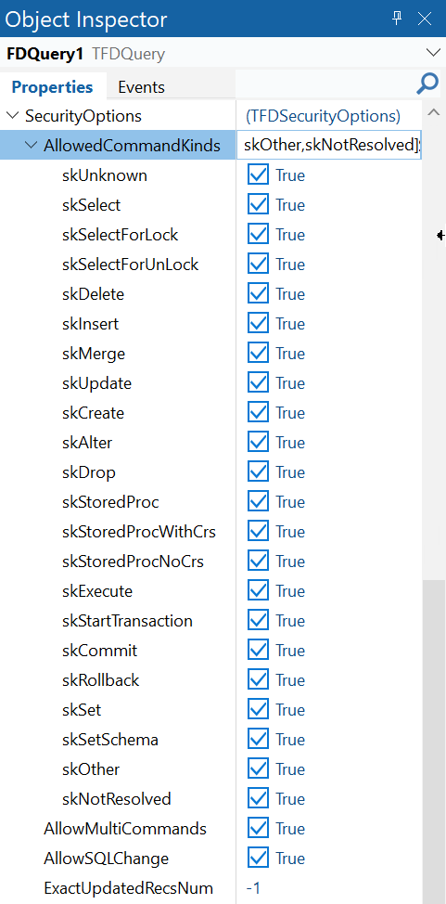
FireDAC Security Options
Showing default values
AllowedCommandKinds (Expanded)
skUnknown, skSelect, skSelectForLock, skSelectForUnLock, skDelete, skInsert, skMerge, skUpdate, skCreate, skAlter, skDrop, skStoredProc, skStoredProcWithCrs, skStoredProcNoCrs, skExecute, skStartTransaction, skCommit, skRollback, skSet, skSetSchema, skOther, skNotResolved
AllowMultiCommands
AllowSQLChange
ExactUpdatedRecsNum

Slide 20
FINALIZATION
Slides and samples
github.com/jimmckeeth/FireDAC-Secret-Weapons

Slide 21
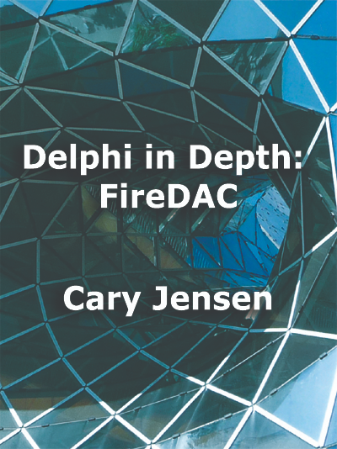
Delphi in Depth: FireDAC
Definitive book about FireDAC
Spirit of Delphi winner Cary Jensen, PH.D.
jensendatasystems.com/firedacbook
Learn how to connect to a wide variety of databases
Optimize your connection configurations
Explore the world of indexes, searches, and filters
Discover the power of persisted datasets
Create flexible queries using macros and FireDAC scalar functions
Achieve blazing performance with Array DML
Master the art of cached updates
Add sophisticated features using Local SQL

Slide 22
END.

